Slide 1
Three-step-authentication
Domain: cyber security
Batch 10
Project Guide: Assistant prof. a Yashwanth
R. Aravind 121710317045 (Team Lead)
P. Vaishnavi 121710317044
Ch.V. Aarathi 121710317010
Varaha Rakesh 121710317051

Slide 2
Abstract
Cyber Security plays an important role in the field of information technology .Securing the information have become one of the biggest challenges in the present day. When ever we think about the cyber security the first thing that comes to our mind is ‘cyber crimes’ which are increasing immensely day by day. Various Governments and companies are taking many measures in order to prevent these cyber crimes. Besides various measures cyber security is still a very big concern to many. This paper mainly focuses on challenges faced by cyber security on the latest technologies .It also focuses on latest about the cyber security techniques, ethics and the trends changing the face of cyber security. In our project we are going to provide 3 step authentication for payment portal for online transactions, this provides authentication to the user as he gets an OTP to the registered mobile number and only after the otp is correct then it gets redirected to the email page, when the user enters the registered email id he gets the link to the biometric app, using this app which must be pre installed in the mobile phone, only after the fingerprint matches the transaction will be completed successfully.

Slide 3
Problem statement
Providing authentication to the user while performing online transaction.

Slide 4
Proposed solution
In our project, we are used three steps for providing authentication to the user.

Slide 5
the 3 steps
LOGIN AUTHENTICATION (USERNAME AND PASSWORD)
OTP GENERATION AND VALIDATION (THROUGH SMS)
BIOMETRIC VALIDATION

Slide 6
PROJECT requirements
Xampp server
Sublime
Php server
Database
Android studio
Collaboration with 2 factor(OTP sender)
Mail server: SMTP

Slide 7
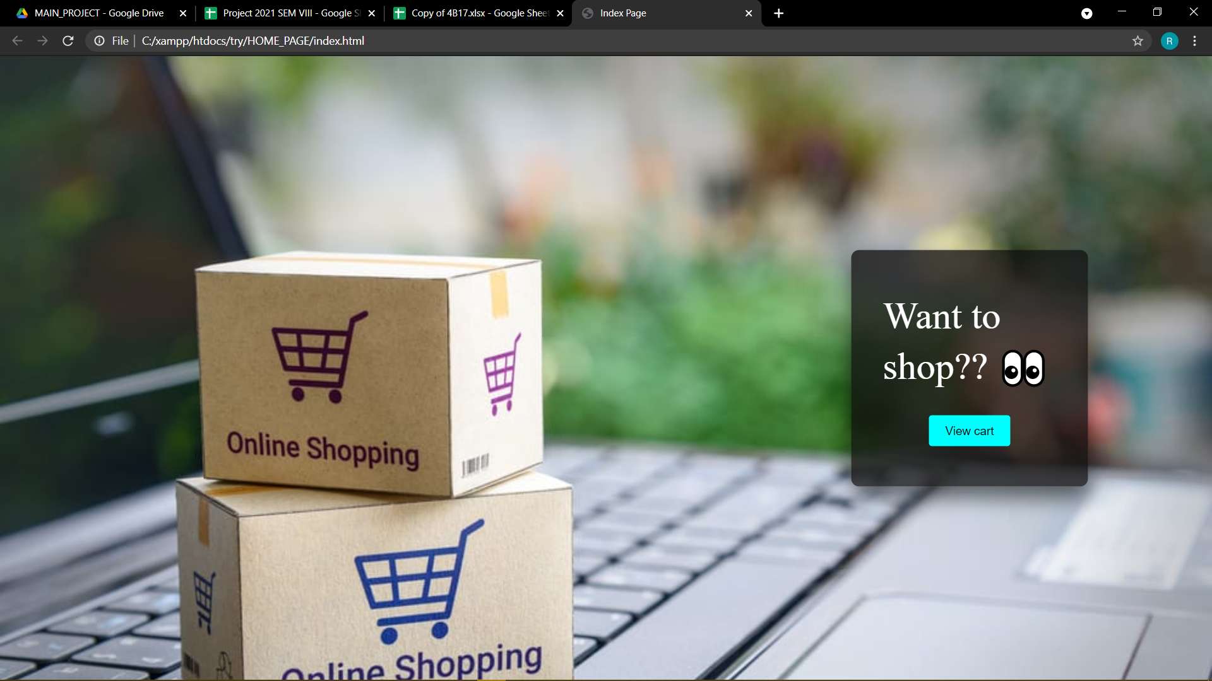
To begin with… the index page

Slide 8
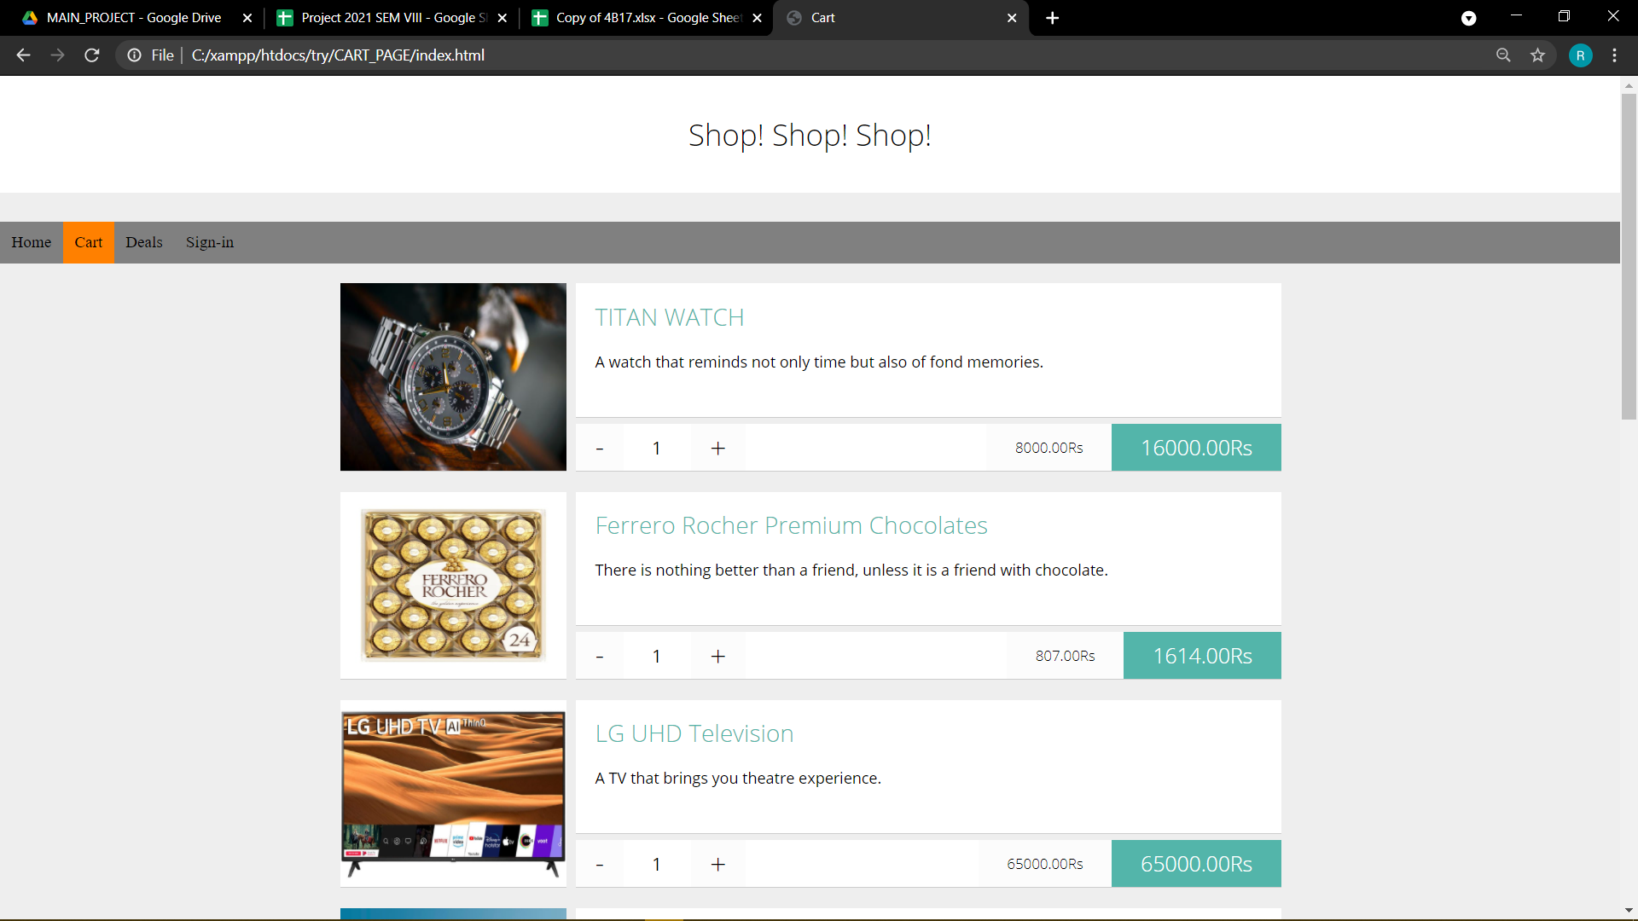

Slide 9
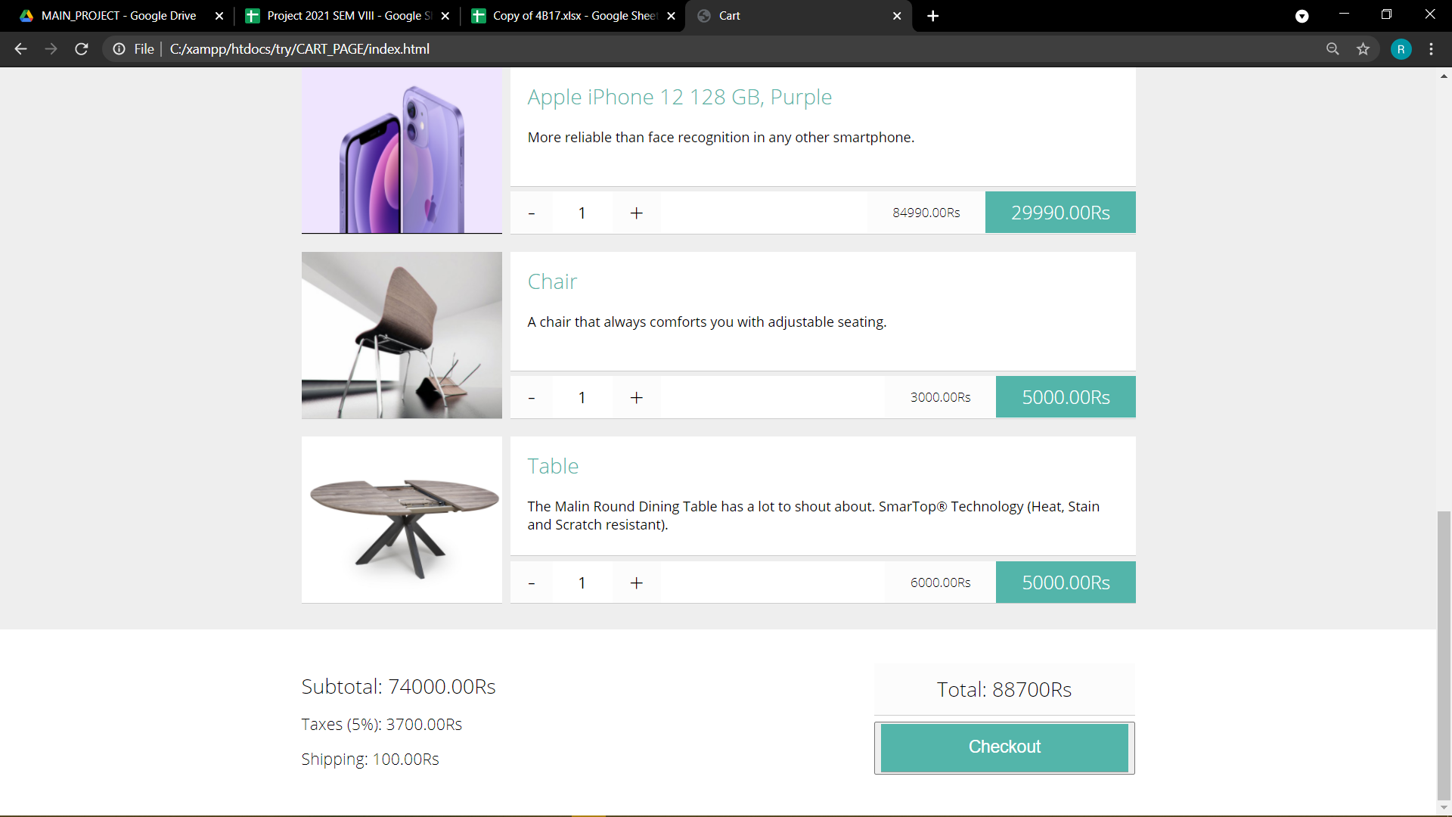

Slide 10
Steps to login: (1st step)
1.Login Authentication is the first step in three step Authentication
2.User should provide username and password
3.Click on Login
4.If the username and the password matches the registered credentials
5.Then it will redirect you to the shopping cart
6.Else It will prompt out Invalid username and password

Slide 11
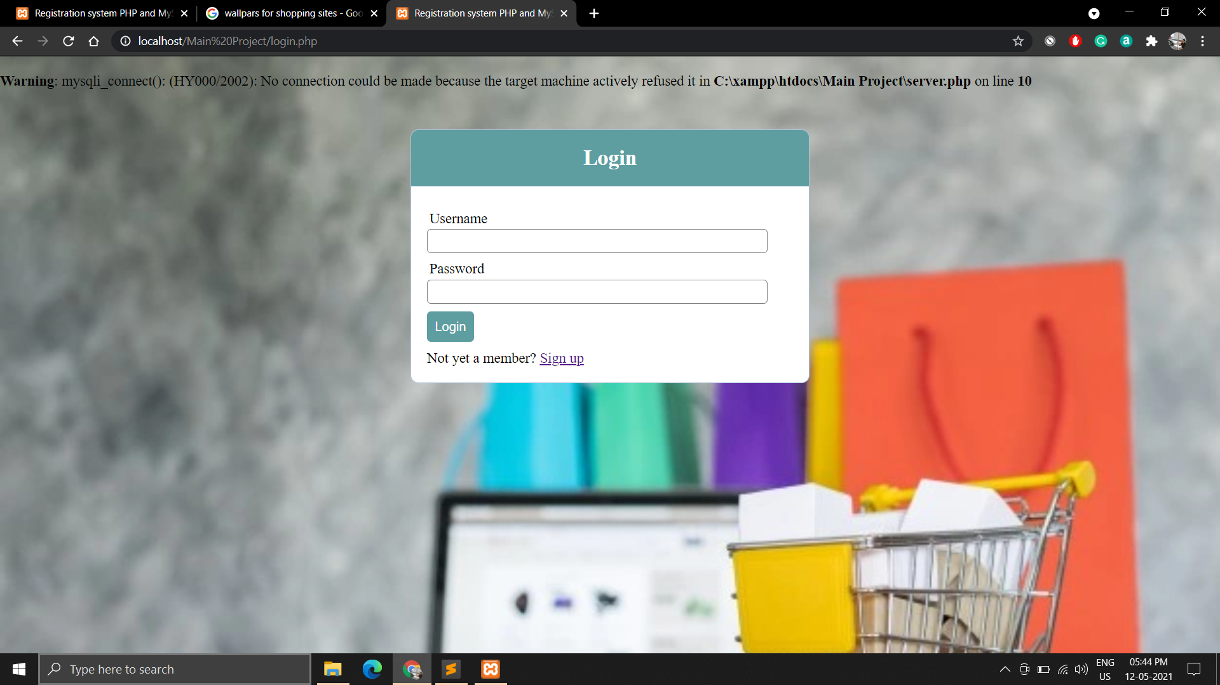

Slide 12
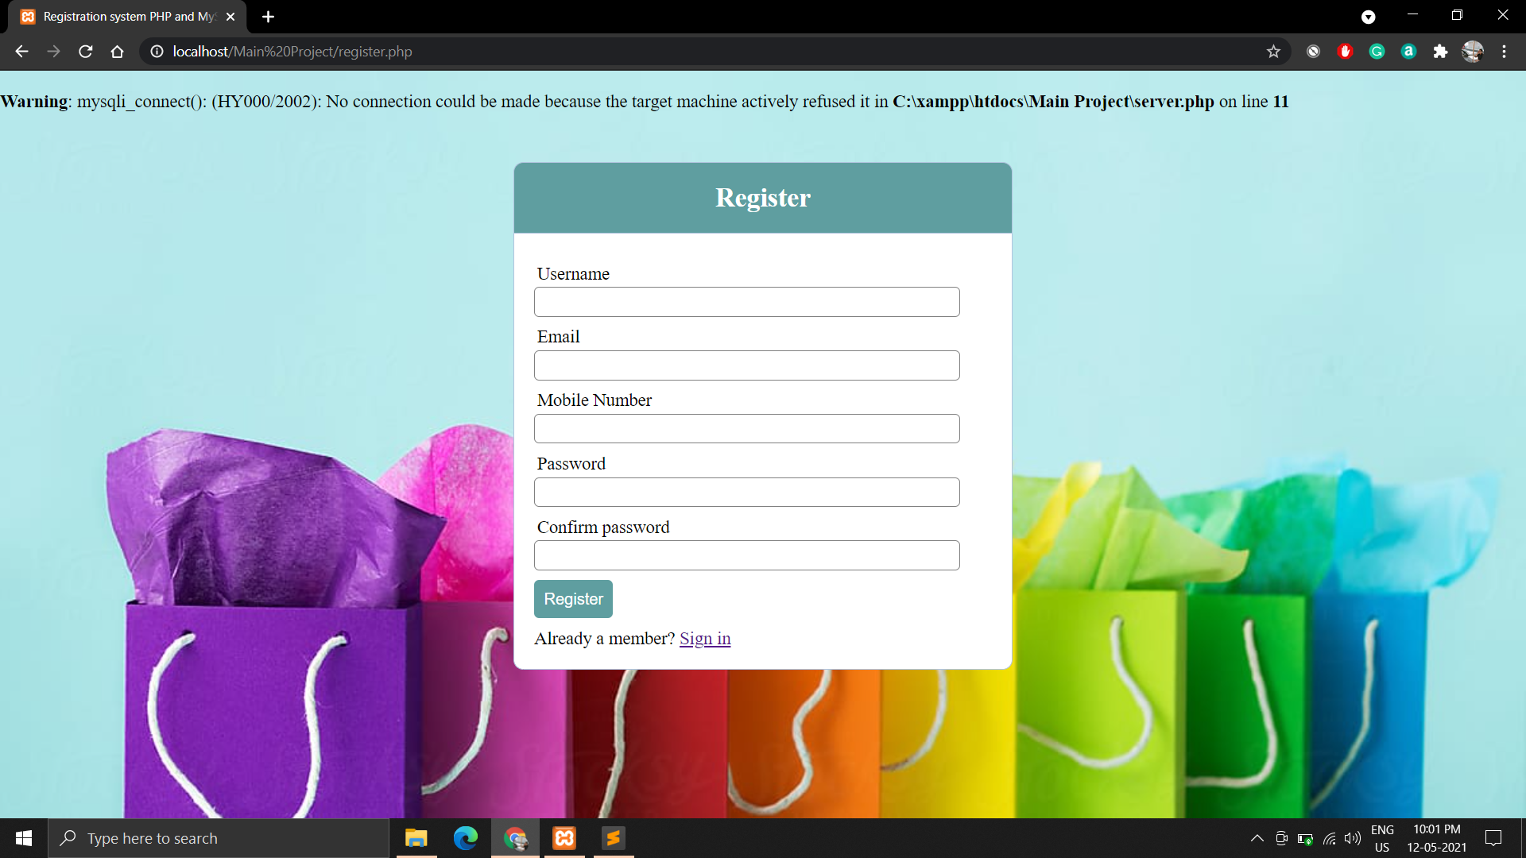

Slide 13
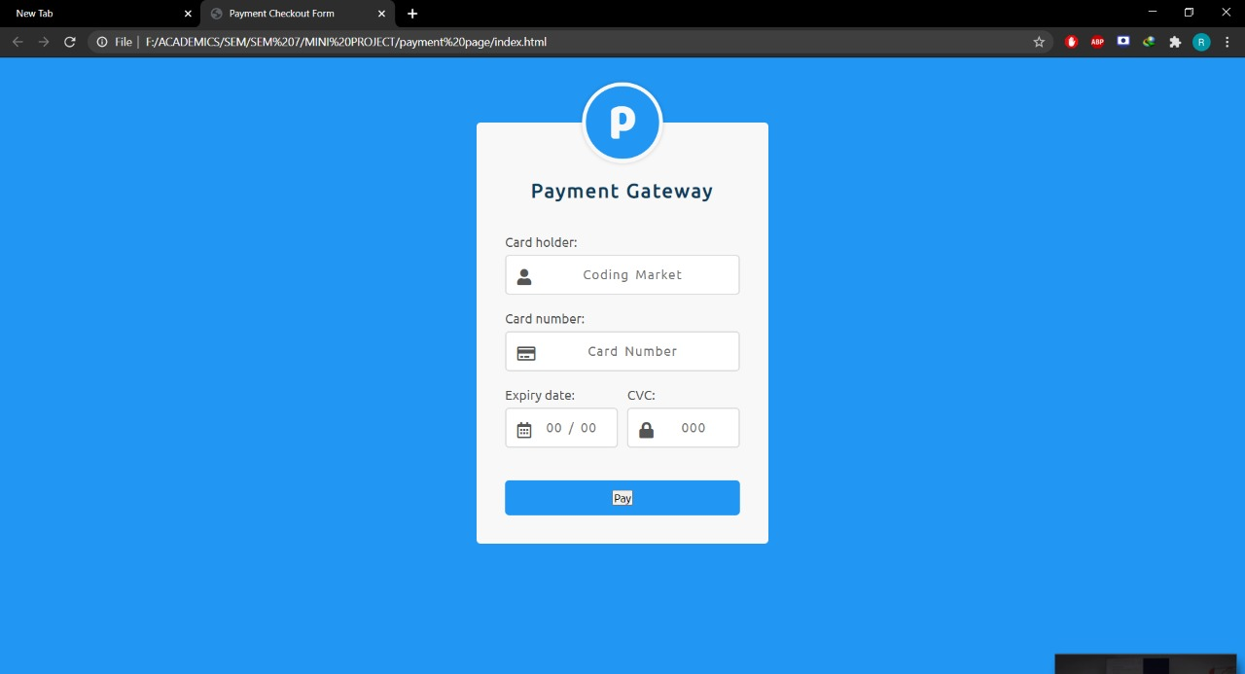

Slide 14
2nd Step of Authentication
1.After the login process you will be redirected to the cart page and then payment page.
2. After you have entered card details and click on pay.
3.You will be redirected to One Time Password (OTP) Authentication.
4.There you have to provide your registered mobile number and click on send OTP.
5.Once the OTP is sent to the mobile number.
6.You have to enter your Received OTP.
7.Click on submit OTP.
8.If the OTP matches It will redirect to biometric authentication page.

Slide 15
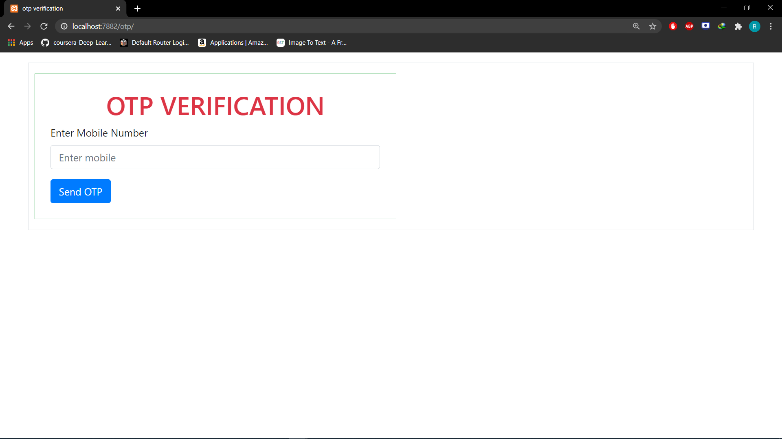

Slide 16
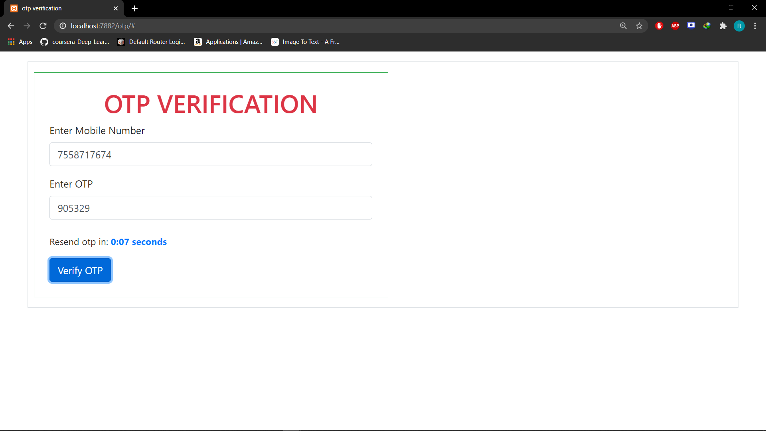

Slide 17
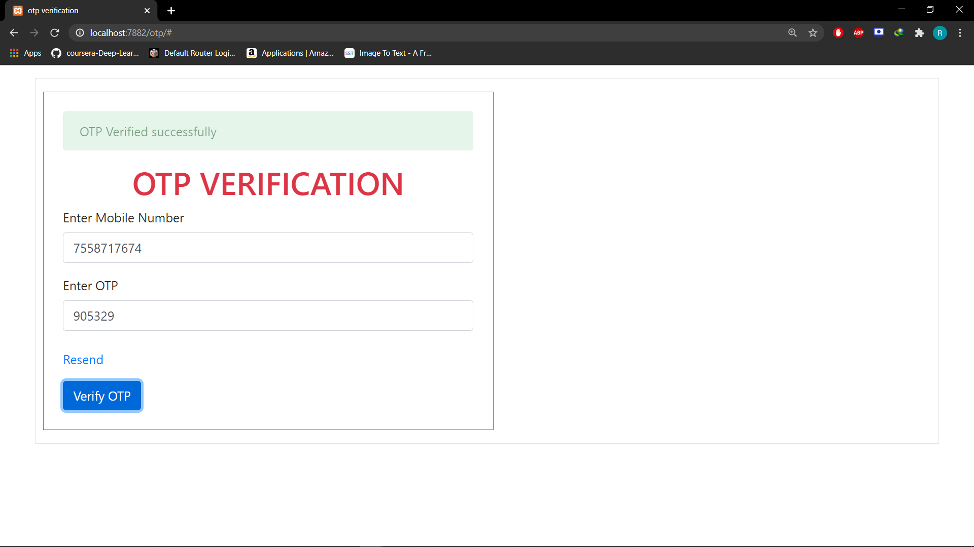

Slide 18
3rd step Authentication
1.After Success OTP validation you will be redirected to the third step.
2.The first Step in third step authentication is, you have to enter your registered mail id.
3.If the user email id matches with the registered email id in the data base then an email will be sent to the user email.
4.In that email, an app link is present which we call as deep-link.
5.Click on that link it will take you to biometric app that you have installed.
6.Put your finger on the fingerprint sensor.
7.If it matches then your payment will be successful or else it will not be successful.

Slide 19
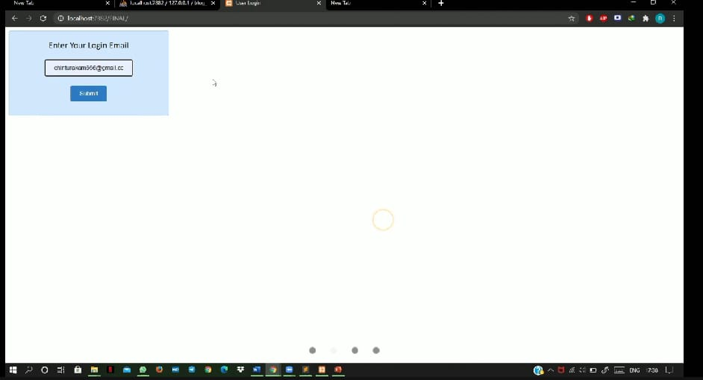

Slide 20
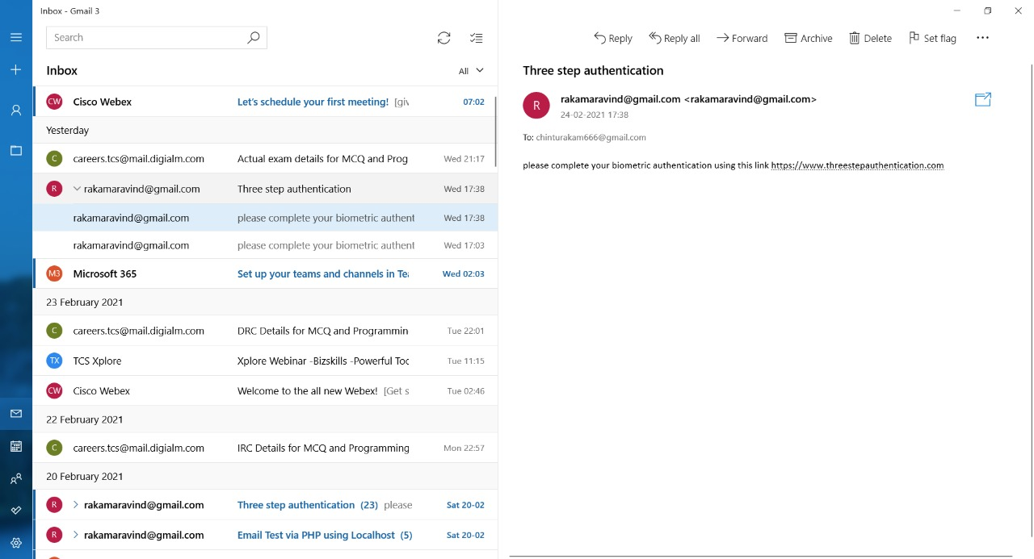

Slide 21
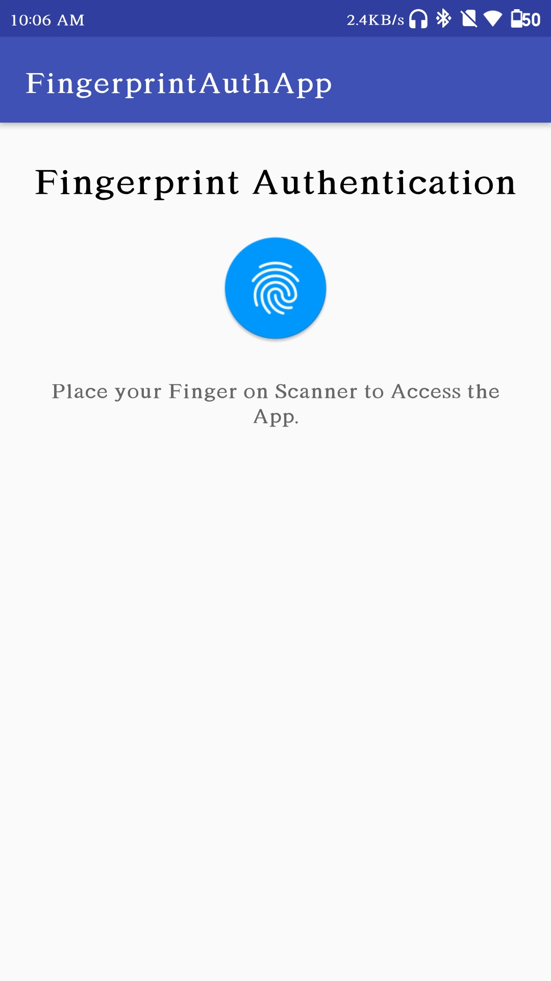
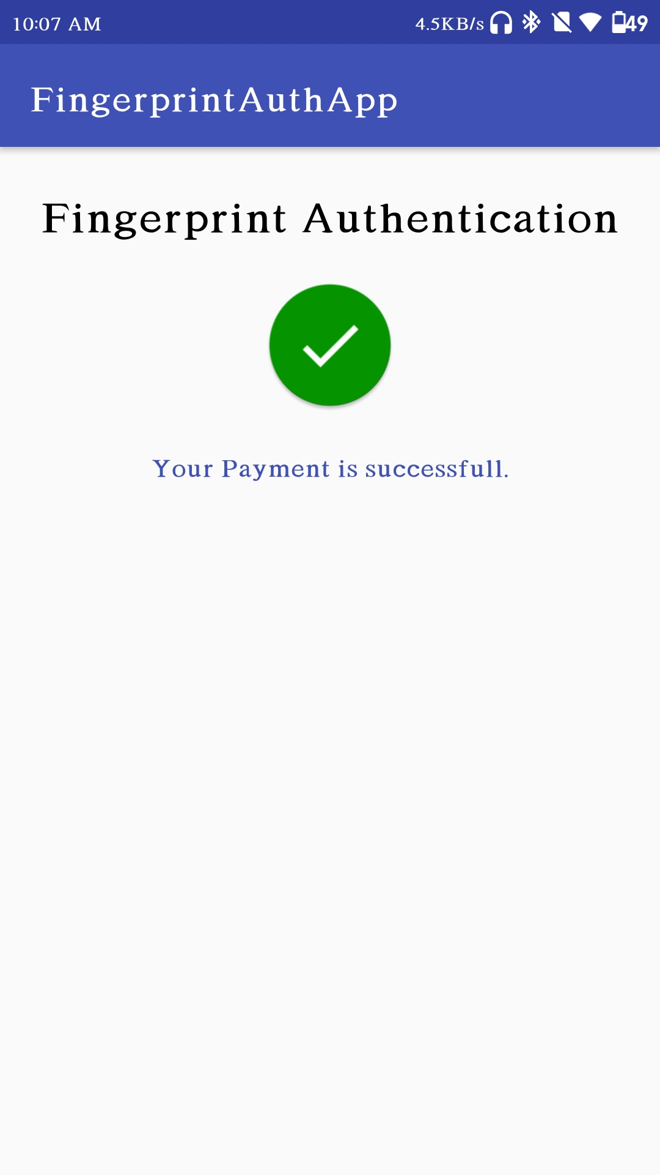

Slide 22
THANK YOU
R. Aravind 121710317045
P. Vaishnavi 121710317044
Ch. V. Aarathi 121710317010
Varaha Rakesh 121710317051

